Slide 1
91907 COMPLEX PROCESSES TO DEVELOP AN OUTCOME L3
2021 MAGS
Evidence of Learning Template
Elliot Bu
13DT3

Slide 2
Project management: Setup
I used Trello and github as my project management tools.
Trello: this one can list my plan and show the steps of creating program.
To compare with Smartdraw, Trello is better, because trello is easy to access and easy to edit the plan, clear to see the plan.
GitHub: github can show my complete programs and also open to everyone.
To compare with the other website, Github had tons of users on here, it has strong coding resources.
These first two tools are helpful with my project management, because trello is the reliable app, it could list the information clearly. For github, there are huge amount of users on that website and i can also save files in my account. I can also get ideas from here(logic of program etc.).
Trello app helped me make the program easily, and when I got lost for what i should do, this leads me to follow the plan that i started before. Github can summary my files as zip files and it is easy to download the whole bunch of files from the user page.

Slide 3
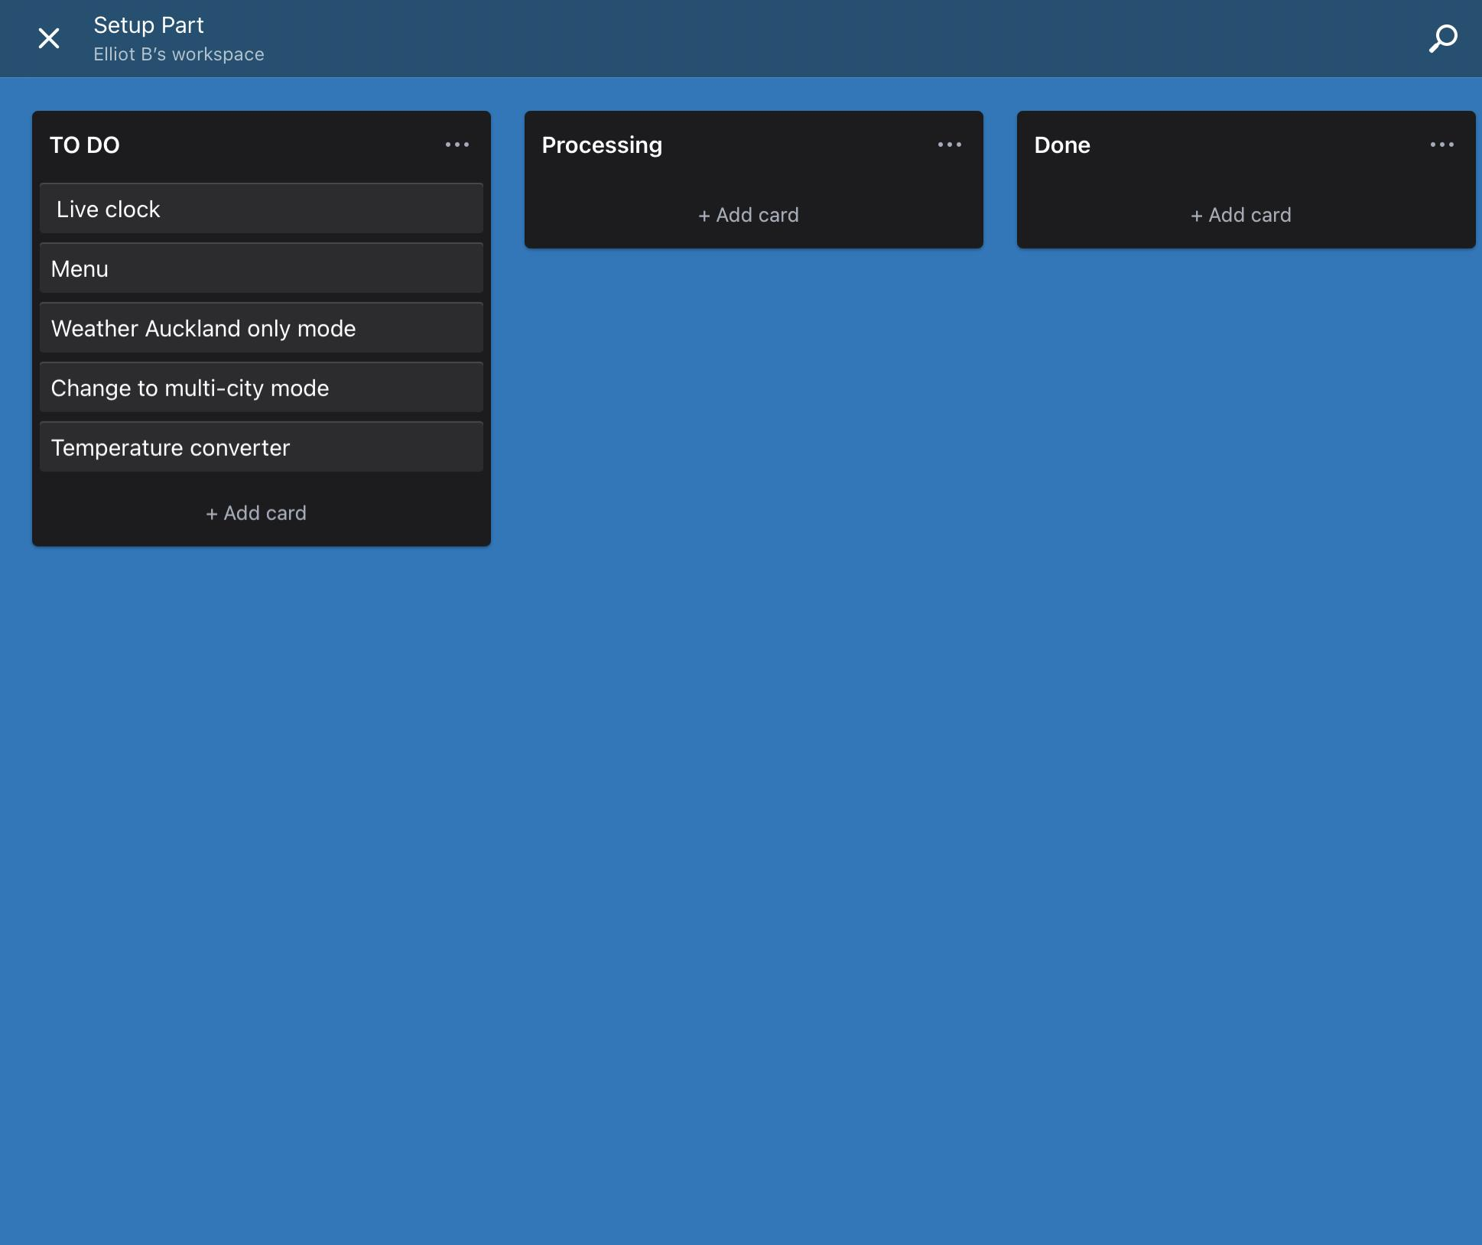
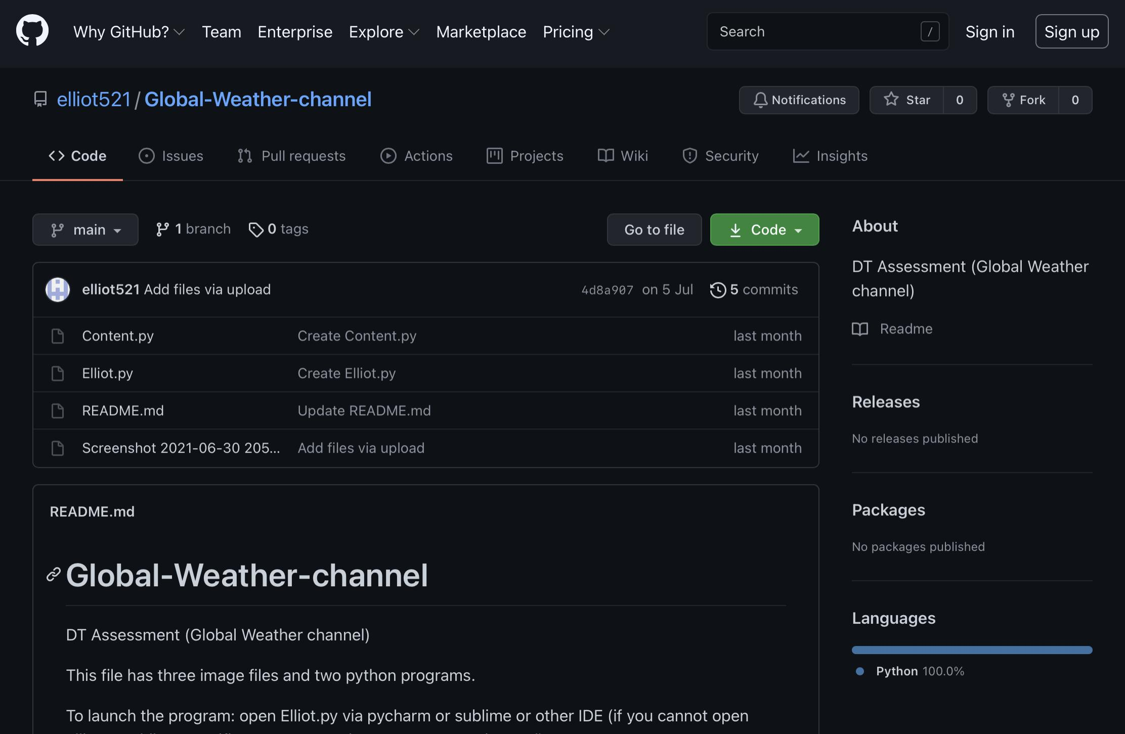
Evidence of setup management tools

Slide 4
Addressing Relevant Implications
The purpose of creating program:
Future proofing
Intellectual property
Usability
Functionality
The project on Github or Drive: <https://github.com/elliot521/Global-Weather-channel>

Slide 5
Program Structure
In this program, there are four parts on here, which are: menu, live clock, weather searching and temperature converter.
Menu: There are two parts: Reference and help, reference has exit and instruction part, exit linked to the system exiting function, so when user click that, the program will be closed. For instruction, there is only one function called “messagebox”, it only showed the guide of this program. Another part help: it includes FAQ and about me. These two function are all created by “messagebox function”.
Live clock: this widget linked to the library called “time”, so it can keep update the latest time over here.
Weather searching:This widget was depending on the API, so when user put their own city name, there will be a list underneath the input button, the input button linked to the list of weather information.
Converter: the input box was linked to the convert button, when users put the random number at input box and clicked convert, it will be the fahrenheit number underneath the input box.
Notes:
Create a diagram showing your program’s structure and outline the classes and functions that you plan on developing. You are welcome to edit this slide once you start developing the outcome BUT when you do that, you should show what has changed and explain why those changes were needed.

Slide 6
Program Structure
Network checker: It has two function, one is when network was connected to the laptop, it will run “content.py”(which is my complete program), actually the “content.py” was connected to the network connection.
And another function called error handling, it was when network was not working and the system will display error message to remind users check their network connection. Make sure the “content.py” goes well.

Slide 7
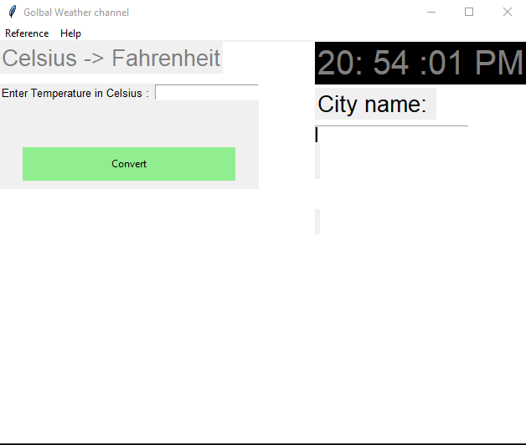
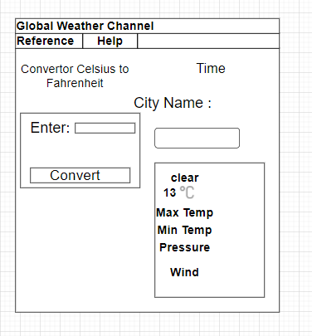
Graphical User Interface Design
Notes:
Create wireframes for your program’s GUI. Please place them on this slide.

Slide 8
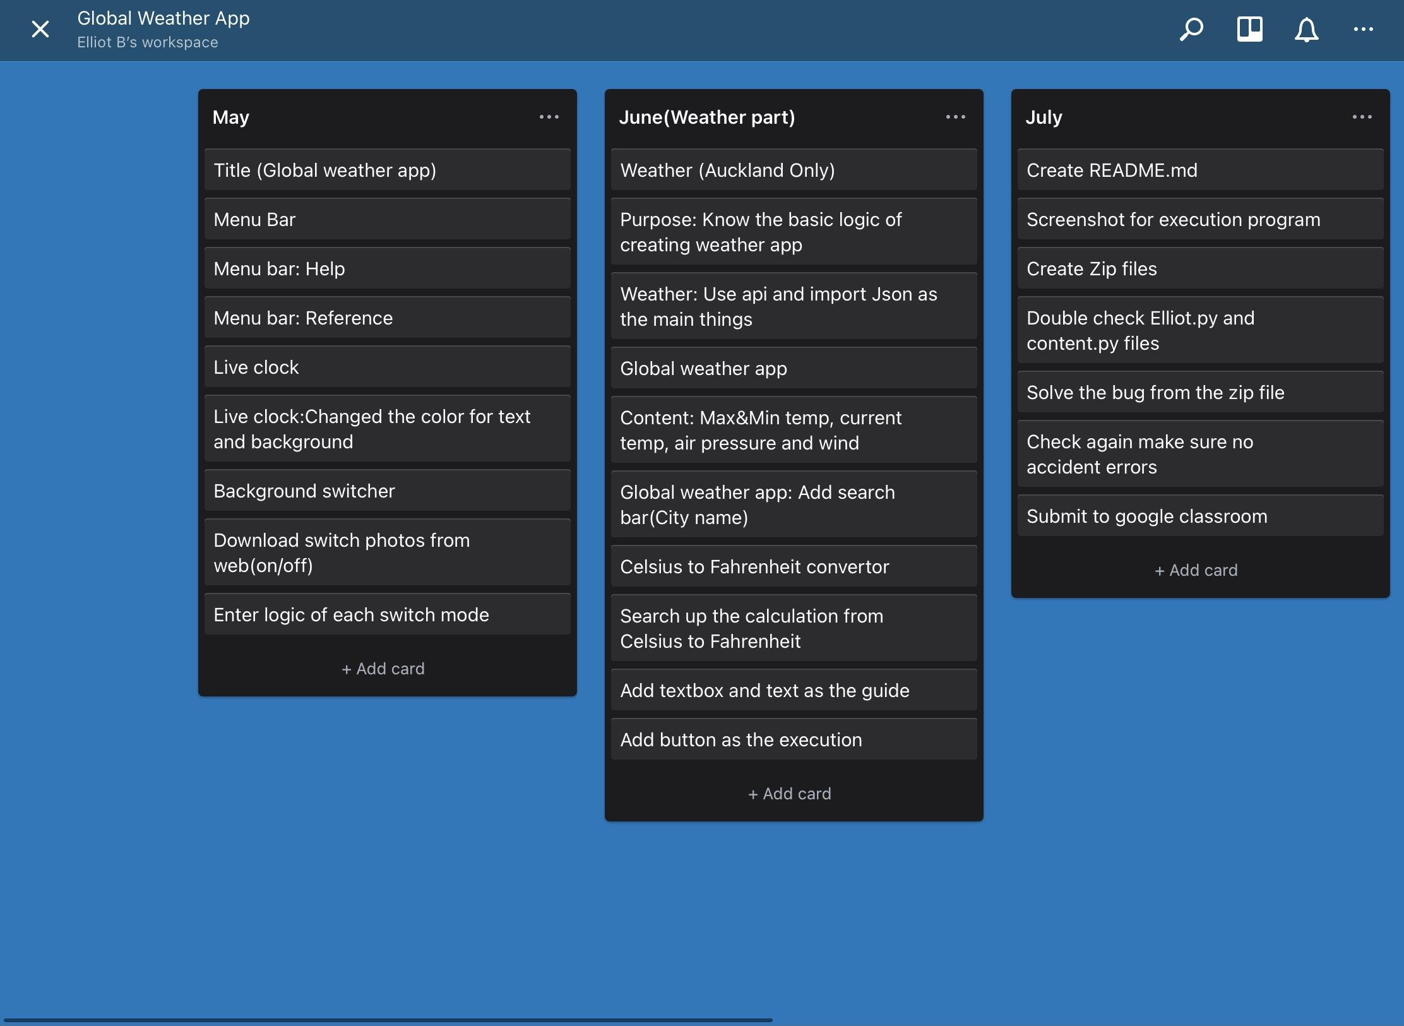
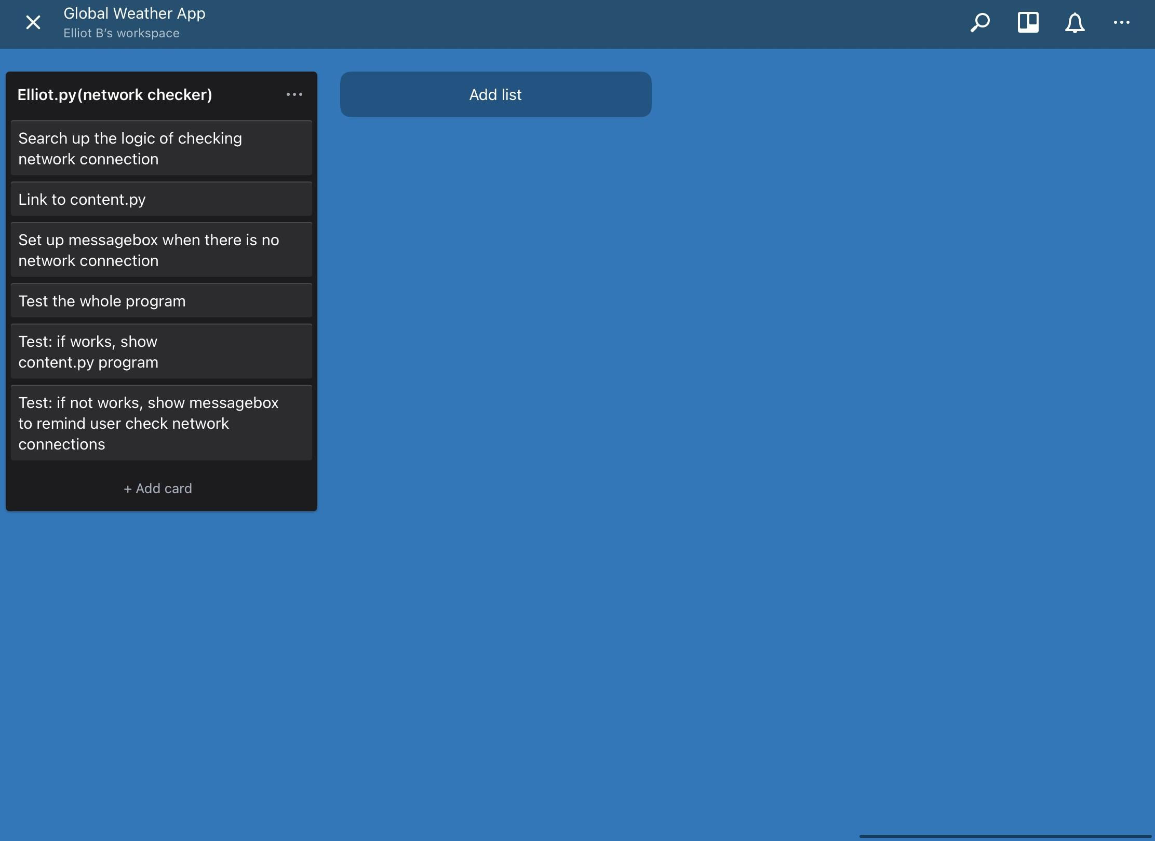
Problem Decomposition
Provide evidence showing that you have decomposed the task. This can be in the form of a trello screenshot or a list of components. If necessary, you may revisit this slide and add to it / edit it as you create your outcome. When you make changes to this slide, please do so in a different colour, date the changes and explain why they were made (this can help provide evidence for M / E grades).
Hint: Use the structure you developed earlier to work out what components you need. For each function, you should have at least one component.
Notes:
Provide evidence showing that you have decomposed the task. This can be in the form of a trello screenshot or a list of components. If necessary, you may revisit this slide and add to it / edit it as you create your outcome. When you make changes to this slide, please do so in a different colour, date the changes and explain why they were made (this can help provide evidence for M / E grades).
Hint: Use the structure you developed earlier to work out what components you need. For each function, you should have at least one component.

Slide 9
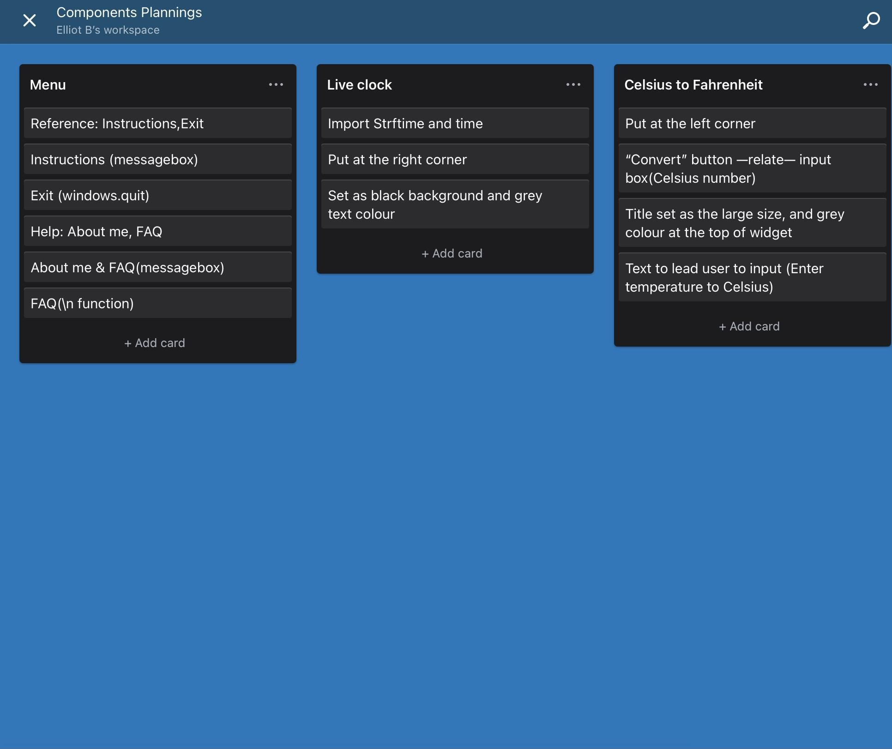
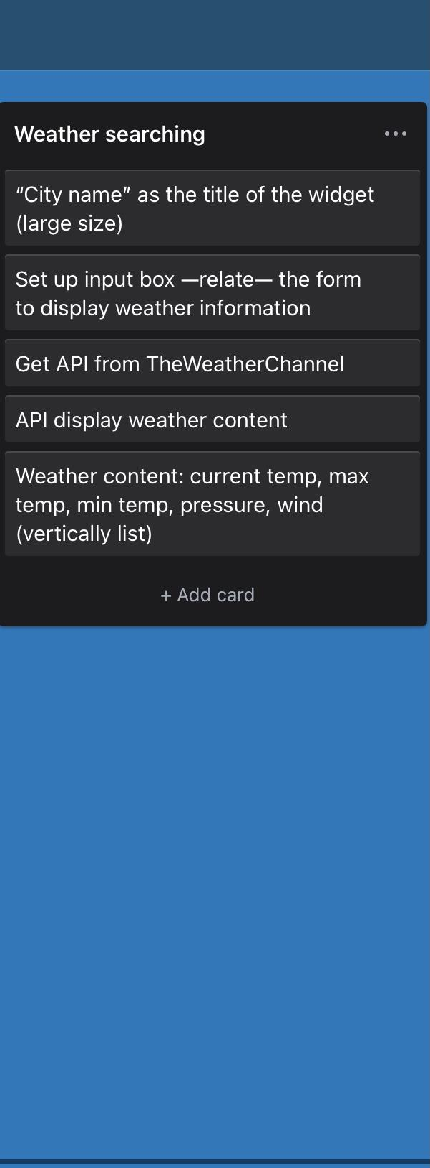
Component Planning
Notes:
Duplicate this slide and use it to show your planning for the current component. This could be in the form of a trello screenshot.

Slide 10
Component Test Plan
To create the GUI interface, this is the easiest part that I should be careful about the
size, because the size could influence the position of the widgets. But first i just create the basic structure first, then when I finish my widgets, i would fix the size of interface.
live clock: This one is easy to be created, my plan is to test the basic logic of this widget, make sure it has no errors. Then i can change the text and background colours as the aesthetic aspects. After testing, there has no errors for the basic logic, and it is just about the colour changing and make sure it looks better than default colour.
Converter: first i should make sure that the button is connected to the “input” bar and also make sure the basic logic(convert value)is correct. Then i can put the widgets at the left corner position. After testing, the button is not related to input box, and I found that at the button part, i did not use command function to relate.
Notes:
Create a test plan for this component BEFORE you start coding. Your plan should allow you to test all logical pathways for this component. It should also include test cases for relevant boundary and unexpected values.

Slide 11
Component Test Plan
Weather searching:
Before testing, i should check the api connection and search bar(make sure it connected to the weather information box). After testing the widget, the weather content did not even display after i entering “Auckland” as the city name. This is the common error and caused by the unconnected network, to fix the error, i connect to the local network, and also set up the reminder file as reminder.(Elliot.py) Api need network connection to get information from website.
Network connection:
This is at another pyfile. If the network was connected, it will open the content.py, and if it is not work, there will be a messagebox to remind user to check their network connection. After i saved as zip file and testing, the messagebox part is work, but the content.py cannot work, so i create the readme.md as the guiding.
Notes:
Create a test plan for this component BEFORE you start coding. Your plan should allow you to test all logical pathways for this component. It should also include test cases for relevant boundary and unexpected values.

Slide 12
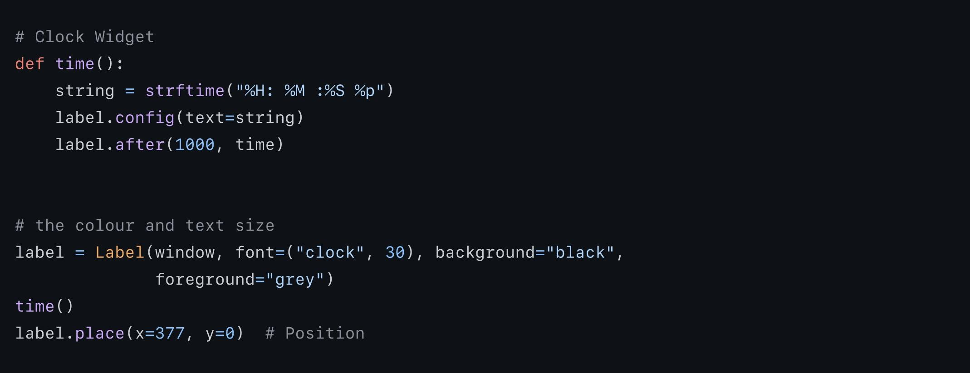
Component Testing Evidence
Live clock :
Notes:
Use this slide to provide evidence that you have tested your component in accordance with the test plan you developed earlier.

Slide 13
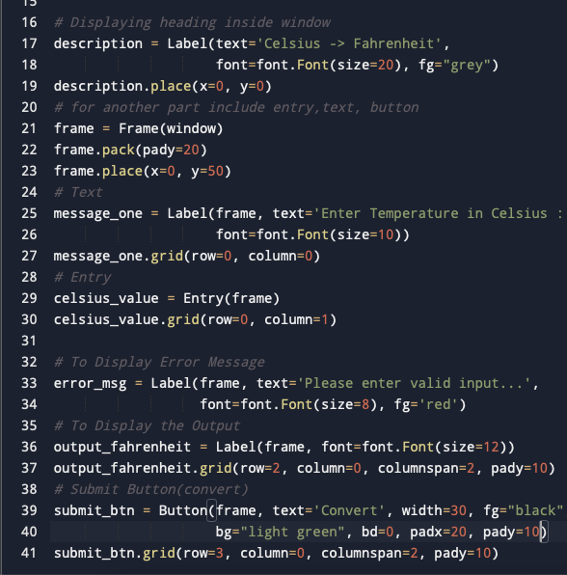
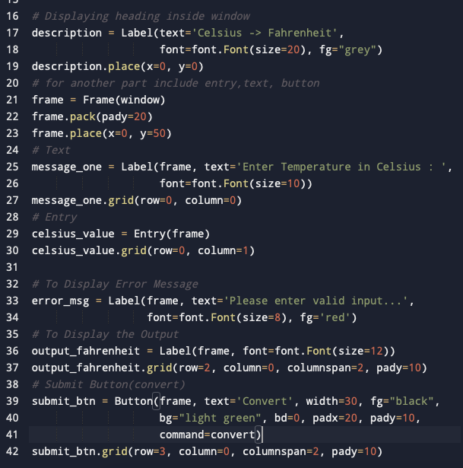
Component Testing Evidence
Converter :
Notes:
Use this slide to provide evidence that you have tested your component in accordance with the test plan you developed earlier.

Slide 14
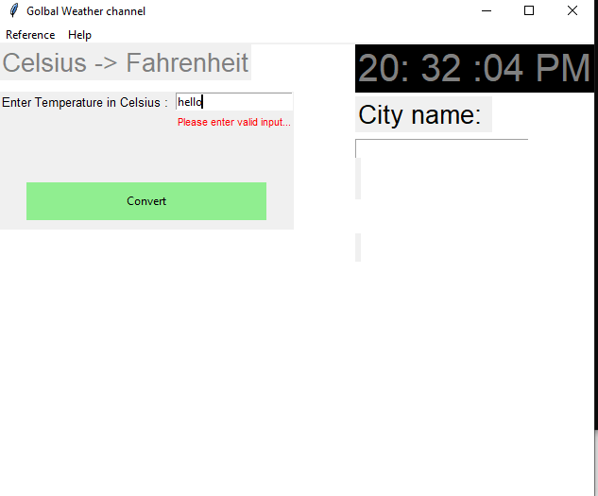
Converter error handling

Slide 15
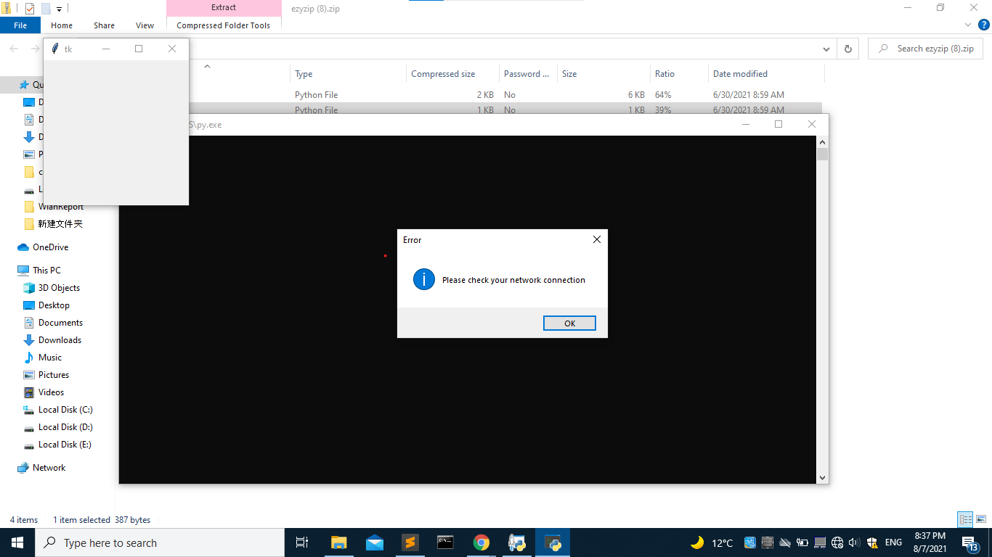
Component Testing Evidence
network checker:
Notes:
Use this slide to provide evidence that you have tested your component in accordance with the test plan you developed earlier.

Slide 16
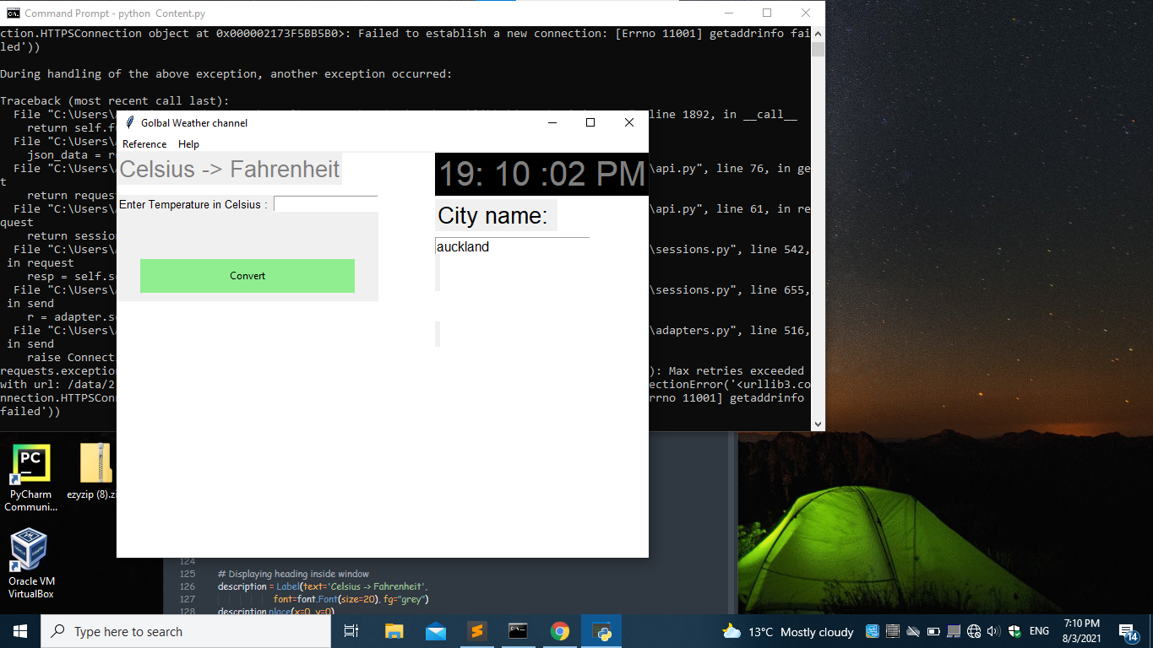
Component Testing Evidence
Weather searching :
Notes:
Use this slide to provide evidence that you have tested your component in accordance with the test plan you developed earlier.

Slide 17
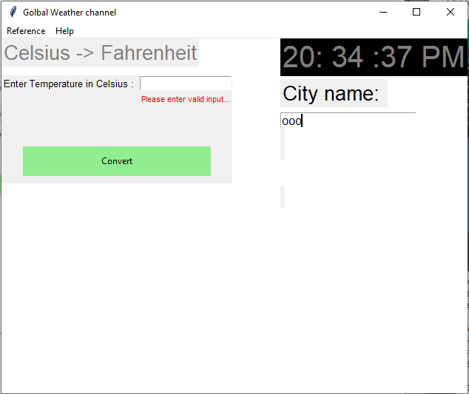
If I randomly put wrong city name, nothing coming out…

Slide 18
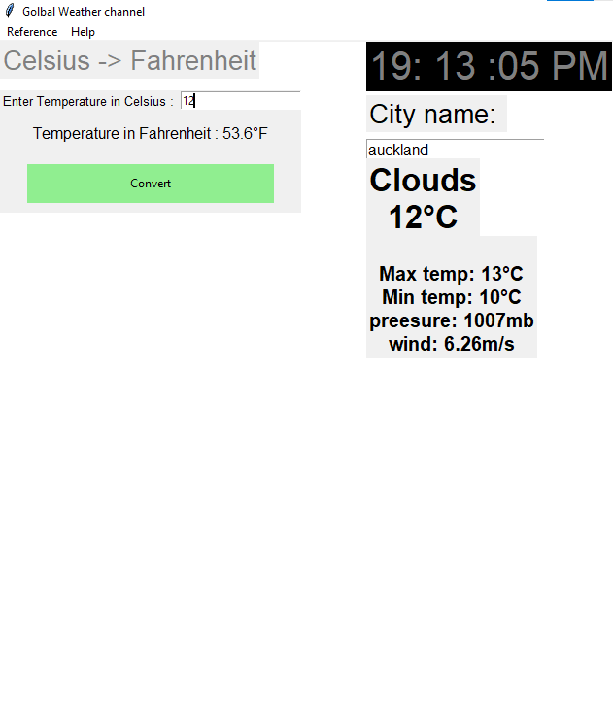
Complete Program
Notes:
Use this slide to provide evidence that you have tested your component in accordance with the test plan you developed earlier.

Slide 19
Complete Program
According to the screenshot of my complete program, this was expected to my test plan.
After I testing my program, every widgets work well, but to make it more functionality, I could add more functions for weather searching part, for example: sunrise/sunset time, weather icon etc.
Converter: I could add the convert value between celsius and fahrenheit and also add some special action to here when user click the button.
live clock: For this part, i could add datetime (Day/Month/Year) above the searching bar and also make it more functionality, or I could also change the text or background colour to make it more aesthetically pleasing.
GUI: The size of GUI is fine, because if i changed the value of the GUI, the other components should also change, but the only thing i should upgrade is the background colour. I could add an image from website or even add smooth colour switcher as the upgrade aspect.
Menu: the role of menu part is to assistant the whole GUI and it is also a guide for users. So I could add the network checker in the “reference” part, and I just used “command” function to relate each other.
Notes:
Use this slide to provide evidence that you have tested your component in accordance with the test plan you developed earlier.

Slide 20
Complete Program(self-testing)
Widget | weather search | temperature converter | Live clock | Menu
Expected | Yes | Yes |  | Yes
Unexpected |  |  | Yes
Program | Content.py | Elliot.py
Expected | Yes | Yes
Unexpected
Notes:
Use this slide to provide a test plan for your complete program. You may wish to create multiple slides so that you can test for expected, boundary and unexpected cases.
Remember to test ALL logical pathways so that you can ensure your program works correctly.

Slide 21
Complete Program(users-testing)
Widget | weather search | temperature converter | Live clock | Menu
pro | Could search all of cities’ weather | Could convert successfully and error handling is cool | 24 hours digital number clock | showed the basic information about this program
con | add more weather information |  | Simple, could add date time | Add more functions
Program | Content.py | Elliot.py
Pro | nice weather searching with converter | Error handling is cool
con | Change the background colours
Notes:
Use this slide to provide a test plan for your complete program. You may wish to create multiple slides so that you can test for expected, boundary and unexpected cases.
Remember to test ALL logical pathways so that you can ensure your program works correctly.

Slide 22
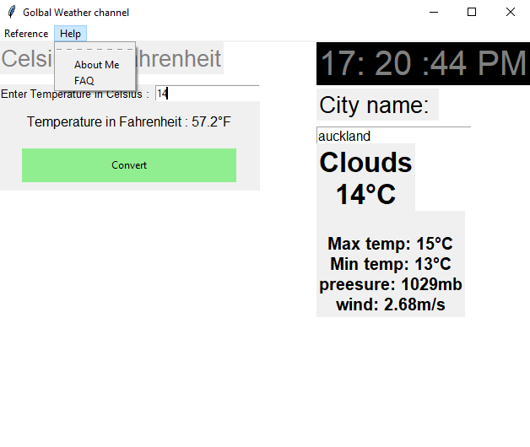
Complete Program <test plan & evidence>
Content.py:
Widgets include weather searching(main), temperature converter, live clock and menu.These are expected for my test plan. My plan is to make every widget work and make sure it does not have any errors. But one little thing i should add, it is to fill the gap between widgets, i could add one more widget to make it complicated even link to the other widget. But the basic functions are working well as my expected.
Evidence:
Notes:
Use this slide to provide a test plan for your complete program. You may wish to create multiple slides so that you can test for expected, boundary and unexpected cases.
Remember to test ALL logical pathways so that you can ensure your program works correctly.

Slide 23
solution from user’s feedback
Background colour:
From user’s feedback, background colours are the easiest part, but i can also create the switch button to form the colour changer, so it is better than non-change.

Slide 24
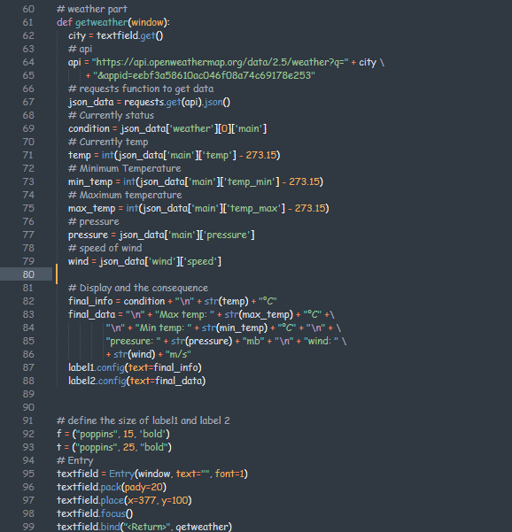
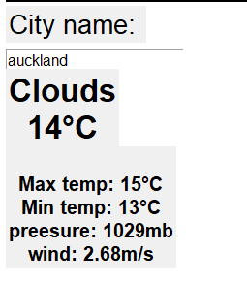
Complete Program <test plan & evidence>
Weather search:
This widget is expected for my test plan, because my plan is to create the weather searching function that include all of the global city, and also make sure there is no error to stop the program running. The information of the weather is specific, but i could add some aspects on here and make it better.
Evidence:
Notes:
Use this slide to provide a test plan for your complete program. You may wish to create multiple slides so that you can test for expected, boundary and unexpected cases.
Remember to test ALL logical pathways so that you can ensure your program works correctly.

Slide 25
solution from user’s feedback
Add weather information:
From the user‘s feedback, i can add more information based on the codes that i typed. To get more idea of the weather information, i can redo the look-up work, and find more weather information, then enter to my original codes.
the extra weather information could be: sunrise/sunset time, icons and the direction of winds. To improve the weather widgets, “prediction” could be the improvement point during this program.

Slide 26

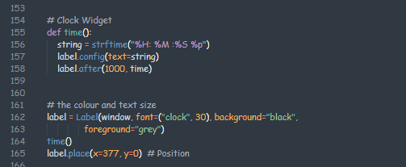
Complete Program <test plan & evidence>
Live clock:
This widget is unexpected for me, because the time was completed, but the date was not displayed on here.
The purpose of using digital number is to clearly show the time, so the users can easily get the time. To make it better, i could change the background colours and text colours, and make it look more aesthetical.
Evidence:
Notes:
Use this slide to provide a test plan for your complete program. You may wish to create multiple slides so that you can test for expected, boundary and unexpected cases.
Remember to test ALL logical pathways so that you can ensure your program works correctly.

Slide 27
solution from user’s feedback
Add date time:
From user’s feedback, i could import the library at the beginning of the codes, i could put “import datetime” at beginning of the whole codes, so that i can use datetime library to my original codes, and arrange the syntax.

Slide 28
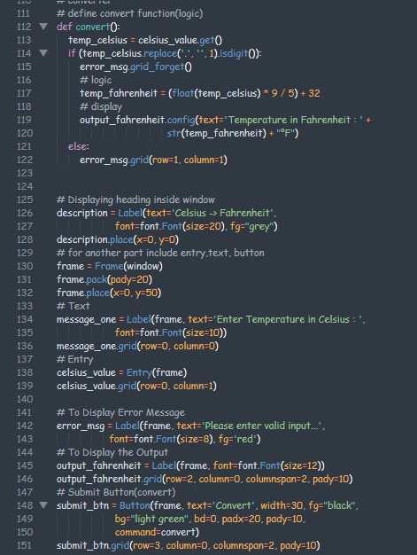
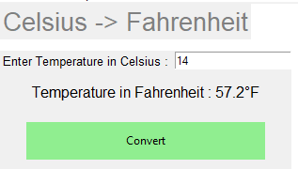
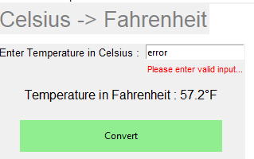
Complete Program <test plan & evidence>
Temperature converter:
This widget is expected for me, because the program run fluently and the error handling is the improvement aspect that i made. This suited for my plan, but one little thing i should improve is to change the colours and make it look more aesthetic.
Evidence:
Notes:
Use this slide to provide a test plan for your complete program. You may wish to create multiple slides so that you can test for expected, boundary and unexpected cases.
Remember to test ALL logical pathways so that you can ensure your program works correctly.

Slide 29
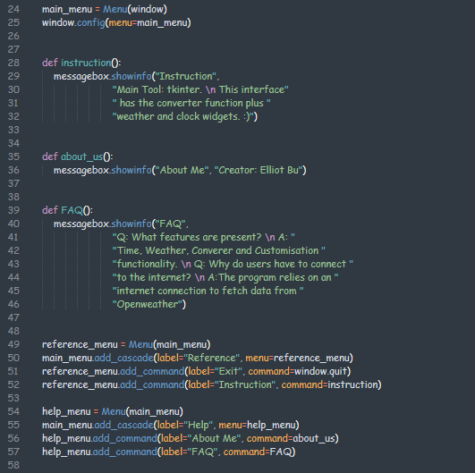
Complete Program <test plan & evidence>
Menu: The menu has two parts at the top of GUI, it suits for my plan, but just compare to other GUI, two functions are not enough for the normal app. So I could add some functions like the timezone for all over the world, the theme changer…… But i made the basic functions which is good, it also suits for my simple program.
Evidence:
Notes:
Use this slide to provide a test plan for your complete program. You may wish to create multiple slides so that you can test for expected, boundary and unexpected cases.
Remember to test ALL logical pathways so that you can ensure your program works correctly.

Slide 30
solution from user’s feedback
Add more functions:
From user’s feedback, there are four little functions for my original program, so i could possibly add: screenshot, text colour changing etc.
This one is actually the reference of this program, so i just make it as helpful as possible to my program.

Slide 31
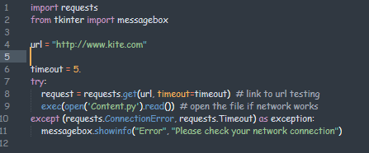
Complete Program <test plan & evidence>
Elliot.py:
This program is expected to my test plan, because what i expected is to make it completely run and no errors. But one little error i met, when i make the file as zip file, it will only run when wifi was not connected. But it did not happen when file was unzipped.
Evidence:
Notes:
Use this slide to provide a test plan for your complete program. You may wish to create multiple slides so that you can test for expected, boundary and unexpected cases.
Remember to test ALL logical pathways so that you can ensure your program works correctly.

Slide 32
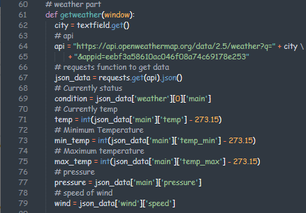
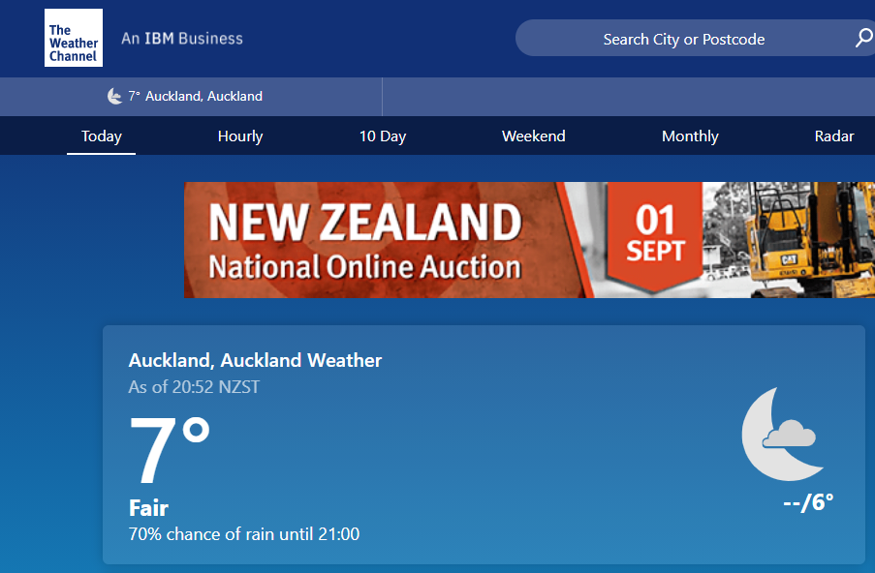
Relevant Implications Addressed
Future proofing:
The information is easy to update, because i used api to connect to the official website, and it can also automatically update. There has no expiry date for my program, and it can keep updating the latest information.

Slide 33
Relevant Implications Addressed
Intellectual property:
I got this idea from youtube, so i just watched some tutorial videos to get ideas and knows some basic logic to form the structure of the widgets.
https://www.youtube.com/watch?v=E9dGOGUeLsk
https://www.youtube.com/watch?v=Sz0_2fp27Q0
https://www.youtube.com/watch?v=7JoMTQgdxg0&t=1168s

Slide 34
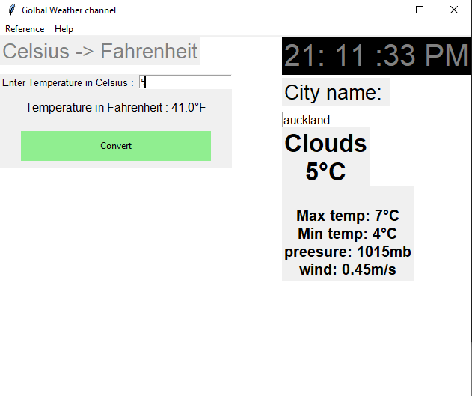
Relevant Implications Addressed
Usability:
The program is not really complicated and it is easy to understand. I also made it more international, because i added the temperature converter for American users. The design was not pretty much messy, so it can be used as the daily app.
Menu
Live clock
converter
Weather searching

Slide 35
Relevant Implications Addressed
Functionality:
So when i enter the “city name” at the weather searching widget, it will quickly show the weather information and it also works correctly. Also work quickly for the temperature converter.
https://youtu.be/Oyt_6fvdwwY

Slide 36
Complex Processes - Discussion
For the whole complex processes, I did live clock first and I tried to add datetime with live time, but i found that it will have the gap with another widget. So i just do the live time and put at the planning position.
Then I started to do the weather search part, I firstly did the simple program, which is only displayed Auckland weather. The purpose of that is to test and know the logic of this widgets. Then I started to create multi-city one as the development.
I also think about this is for global users, it also included the American users, so I created the temperature converter as the shortcut, so i looked up from website about the convert value between Celsius to Fahrenheit, then I entered data to the program, and also setup the error handling when users did not enter the number.
Finally, I did the menu part, which is the easiest one. It is mainly including the messagebox and exit function, so this part is only about the information that i should enter. It also assistant users to use the app.
Notes:
Discuss how you used (and combined) information gained from the planning, testing and trialling of your components to improve the quality of your program. Note that synthesising information from planning, testing and trialling of components and then discussing how this lead to a high quality outcome are needed for an E grade.

Slide 37
Complex Processes - Discussion
To make the works look professionally, I added the network checker so it will serve API and network connection. This program is to check the network connection so that the weather function will work fluently.
From the retrospection above, there are few things i should improve. From the whole processes, i have done the basic function based on the widgets, but i could add more colours to make it look more aesthetically.
Then i could add more options for menu part and more functions to this program, the network checker should not only include the error handling, but i can add some actions on here, such as: emoji. so that made it more professionally.
Notes:
Discuss how you used (and combined) information gained from the planning, testing and trialling of your components to improve the quality of your program. Note that synthesising information from planning, testing and trialling of components and then discussing how this lead to a high quality outcome are needed for an E grade.

Slide 38
Walk through of my project
Link: https://youtu.be/FRl5liW7XuQ
(This is my youtube video and recorded by my own laptop.)

